Slide 1
LINKED LIST
DEFINITION
A linked list is a linear data structure. Its elements can be traversed using pointers. Linked list is made up of nodes, Nodes represent those data elements, and links or pointers connect each node.

Slide 2
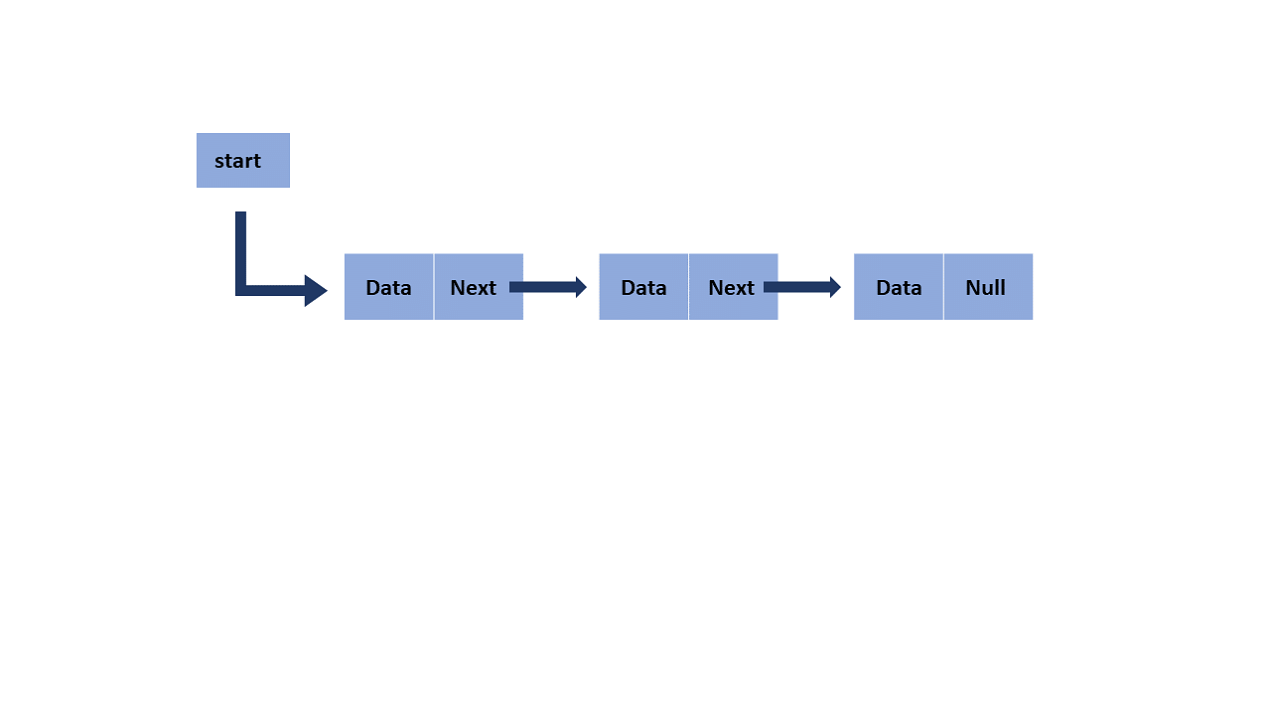

Slide 3
A linked List
The last node contains null in its second field because it will point to no node.
A linked list can grow and shrink its size, as per the requirement.
It does not waste memory space.

Slide 4
TYPES OF LINKED LIST
There are four types of linked list:
Singly linked list
Doubly linked list
Circular linked list
Circular doubly linked list

Slide 5
SINGLY LINKED LIST
Singly linked list is a linear data structure made up of nodes. These nodes have two parts which include;
Data
Reference of next node

Slide 6


Slide 7
OPERATIONS OF SINGLY LINKED LIST
INSERTION
DELETION
At the beginning
At the last
At a specific position

Slide 8
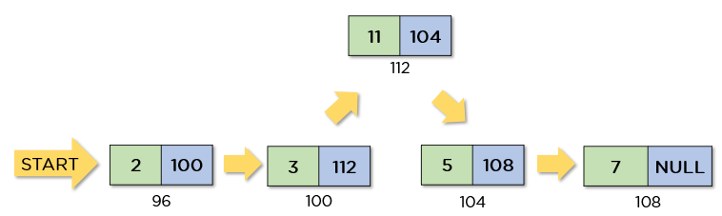
INSERTION
Dg.insertion

Slide 9
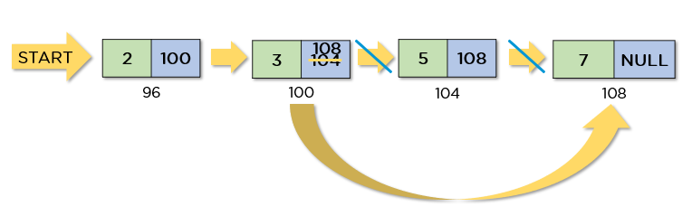
DELETION

Slide 10
What are the benefits of a singly linked list?
You can perform operations like insertion and deletion with ease
It is a dynamic data structure, i.e., it does not have a fixed size
It doesn’t require the movement of needs for insertion and deletion
It doesn’t need elements to be stored in consecutive memory spaces
It doesn’t waste space as it uses space according to the requirement

Slide 11
What are the limitations of a singly linked list?
It requires more storage space because it also stores the next pointer with data.
If you have to reach any node, then you have to go through every node before it.
You can’t traverse it from anywhere but the head node.
It requires a different amount of time to access any elements
Sorting is complex in this linked list.

Slide 12

DOUBLY LINKED LIST

Slide 13
A Doubly linked List..
Doubly linked list is a linear data structure made up of nodes
We can traverse it in both directions. It nodes have three parts.
DATA
Reference to the next node
Reference to the previous node

Slide 14
OPERATIONS OF A DOUBLY LINKED LIST
TRAVERSAL
INSERTION
DELETION

Slide 15
TRAVERSAL
Normal traversal
From head node to tail nodes.
Reverse traversal
From the tail node to the head

Slide 16
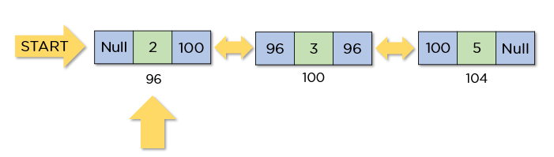

Slide 17
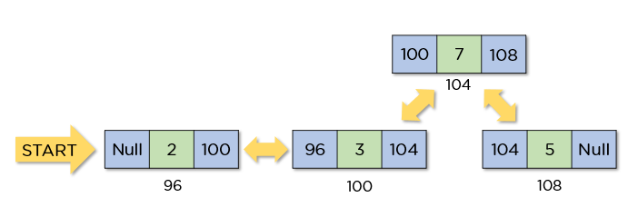
INSERTION

Slide 18
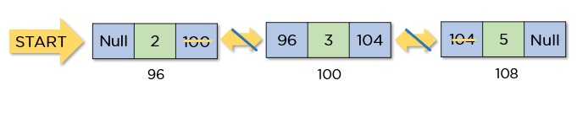
DELETION

Slide 19
What are the benefits of doubly linked list?
It is easy to reverse this linked list.
It is easier to delete a node from this linked list as compared to a singly linked list.
During its execution, it can easily assign or reassign memory.
Reverse traversal is faster in this linked list.
You can implement complex data structures like stacks and binary trees.

Slide 20
What are the limitations of a doubly linked list?
It requires more space for each node because these nodes have an extra pointer.
Its insertion and deletion operations are slower than singly-linked lists as it requires more steps.
Because of random storage in memory, elements need to be accessed sequentially.

Slide 21
CONCLUSION
Doubly linked list is a dynamic data structure
Doubly linked list are faster at insertion and deletion
Doubly linked list is a bidirectional linked list i.e. , They can be done in both directions.

